Slide 1
SQL Capstone Project
Title :- Amazon Sales Analysis Presentation
Name :- Darshan Raj G
Date :- 01-05-2024

Slide 2
Agenda
Product Analysis
It is basically to understand the different product lines, the products lines performing best and the product lines that generates more revenue.
Sales Analysis
The main aim of this analysis is to help with measuring the effectiveness of each sales strategy and also to modify if needed to gain more sales.
Customer Analysis
This analysis aims to uncover the different customer segments, purchase trends and the profitability of each customer segment

Slide 3
Objectives
Branch Performance
Product Line Analysis
Customer Behavior
Sales Trends
Payment Methods
Customer Satisfaction
Tax and Gross Margin Analysis
City Analysis
Code Overview
Conclusion

Slide 4
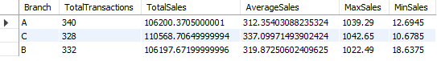
Branch Performance
Summary of sales performance for each branch (A, B, and C)
By the above table we can come to know than branch “C” is performing better than branch “A” and branch “B”

Slide 5
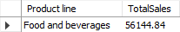
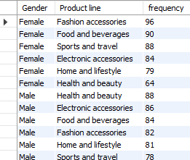
Product Line Analysis
Product line that is having the highest sales
product line is most frequently associated with each gender

Slide 6
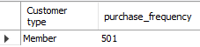
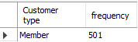
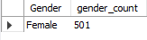
Customer Behavior
the customer type contributing the highest revenue
customer type occurs most frequently
the predominant gender among customers

Slide 7
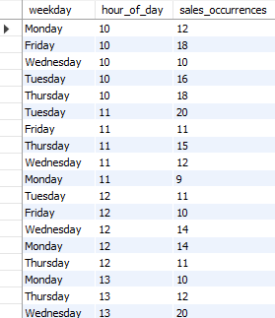
Sales Trends
the sales occurrences for each time of day on every weekdays

Slide 8
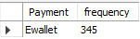
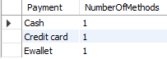
Payment Methods
payment method occurs most frequently
the count of distinct payment methods in the dataset

Slide 9
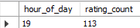
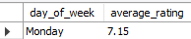
Customer Satisfaction
the time of day when customers provide the most ratings
the day of the week with the highest average ratings

Slide 10
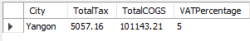
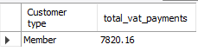
Tax and Gross Margin Analysis
the city with the highest VAT percentage
the customer type with the highest VAT payments.

Slide 11
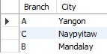
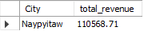
City Analysis
For each branch, what is the corresponding city
which city was the highest revenue recorded

Slide 12
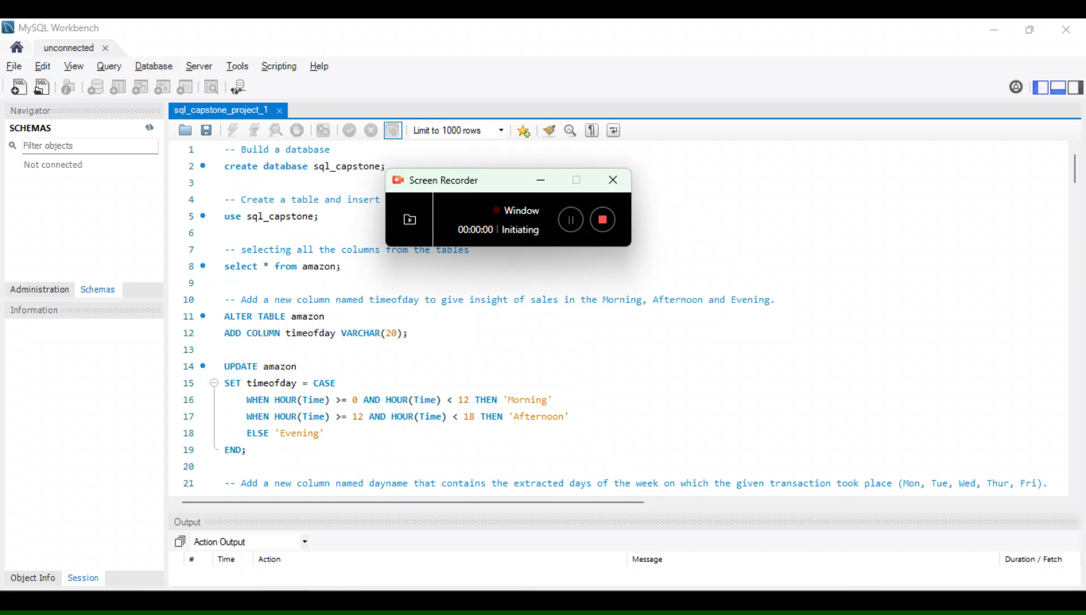
Code Overview

Slide 13
Conclusion
Product analysis
There are mainly 6 products in the product line.
Where “Food and beverages” are most selling products and also “highest revenue generating” product
Highest rated products are:
Food and beverages - 7.11
Fashion accessories – 7.03
Health and beauty - 7

Slide 14
2. Sales Analysis
Looking at the sales data branch “C” has made highest sales.
There are three distinct payment methods: Cash, Credit card, and Ewallet
The city with the highest VAT percentage is “yangon”, suggesting higher tax implications for transactions in that city.
3. Customer Analysis
There are two types of customers “Member and Normal”
those who are having the “membership in the branch”, are the customer type contributing the highest revenue
More frequent customers type are “Member”
Most of the customers give rating around “8:00 PM -9:00PM”

Slide 15
Thank You

